Slide 1
MIREOT Minimum information to reference external ontology terms
Jie Zheng and Yongqun (Oliver) He
2011 ICBO OBI Tutorial

Slide 2
What is MIREOT?
MIREOT stands for Minimum Information to Reference External Ontology Terms
A mechanism to import terms of interest from an external resource to a target ontology

Slide 3
Why MIREOT?
Creating new terms in the target ontology and referring back to an external resource leads to redundant effort and terms.
Extracting and importing modules (including axioms) is difficult.
Import of a whole ontology has a huge overhead and may cause inconsistencies and unexpected inferences.

Slide 4
What is the minimal information required to refer toaterm inanexternal resource?
URI of the class
URI of the source ontology
Position in the target ontology
this minimal set allows unambiguous identification of a term

Slide 5
Additional information
Label
Definition
Synonym
Other annotations

Slide 6
MIREOTingautomatically
Perl + Lisp scripts
used by OBI developers
OntoFox
Web-based tool that can be easily used by all developers (compare to OBI implementation)

Slide 7
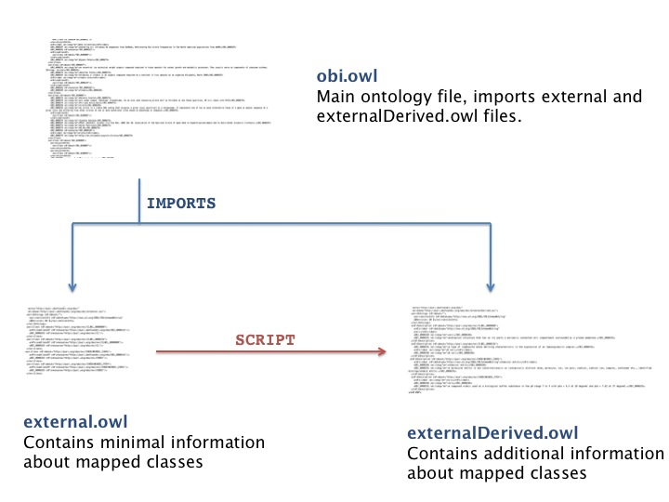
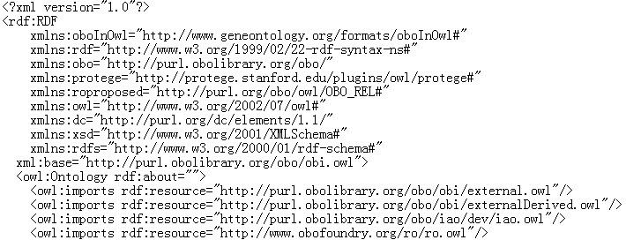
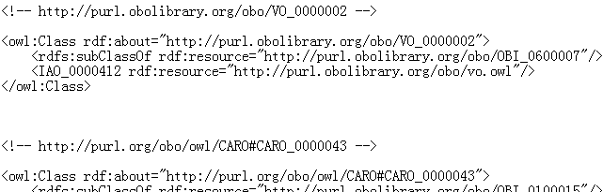
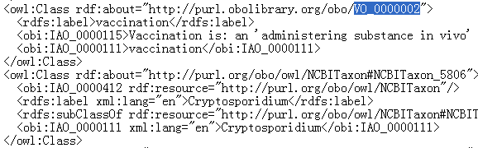
Scripts used by OBI
3
URI of external term
Position in the
target ontology
URI of the source ontology
1
2
Perl script
Lisp script

Slide 8
Useful Links
Scripts are available under our SVN repository:
http://purl.obolibrary.org/obo/obi/repository/trunk/src/tools/
add-to-external.pl
http://purl.obolibrary.org/obo/obi/repository/trunk/src/tools/build
create-external-derived.lisp
Detailed tutorial of the scripts:
http://obi-ontology.org/page/Tutorials#MIREOT

Slide 9
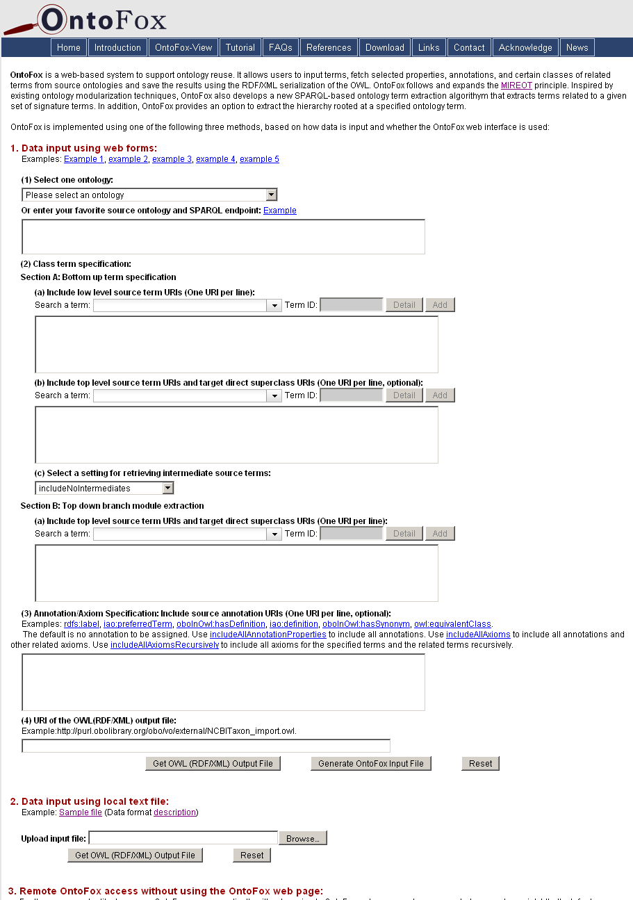
OntoFox: a Web Server for MIREOTing
Based on the MIREOT principle
Web-based data input and output
Output OWL file can be directly imported in your ontology
Easy to use
No programming needed for users
http://ontofox.hegroup.org

Slide 10
Acknowledgements
MélanieCourtot
Frank Gibson
Allyson L. Lister
James Malone
Daniel Schober
Ryan R. Brinkman
Alan Ruttenberg
Zuoshuang(Allen) Xiang
The OBI Consortium

Slide 11
Community View of OBI
Jie Zheng and Yongqun (Oliver) He

Slide 12
OBI
Over 20 different communities involved in OBI development
Each community frequently uses a subset of OBI terms
Each community may have its own community preferred labels

Slide 13
Community View
Annotation property approach
Tag the termsforwhich a specific community is interested
Provide community-preferred labels
Example usage of annotation property ‘alternative term’
FGED alternative term
IEDB alternative term

Slide 14
View Implementation
Tag terms using community-specific annotation property
Option 1: Add annotation property in the terms in obi.owl directly
Option 2: Mark the terms in a spread sheet
Extract the tagged subset of obi.owl including all related terms and axioms based on community-specific annotation property
OntoFox-View: OntoFox-based community view generator (under development)

Slide 15
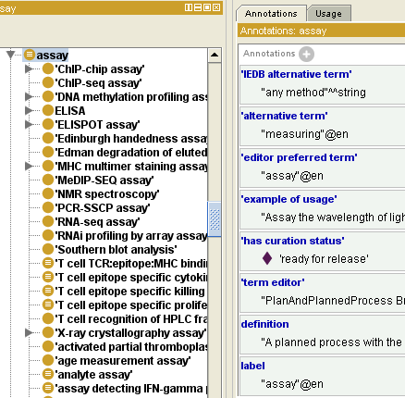
OntoFox-View: Option 1
load
RDF store
(obi.owl)
SPARQL
quires
OntoFox-View
OWL(RDF/XML)
output file
IEDB alternative term
obi.owl
Extract terms with ‘IEDB
alternative term’ property and
all the axioms related to them

Slide 16
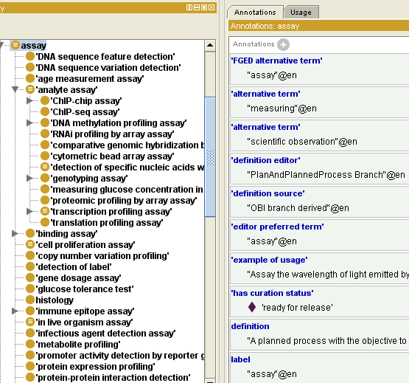
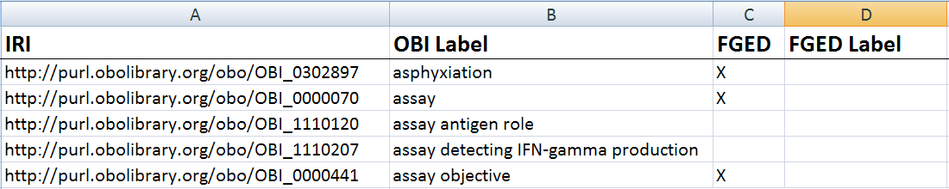
OntoFox-View: Option 2
RDF store
(obi.owl)
SPARQL
quires
OntoFox-View
OWL(RDF/XML)
output file
FGED alternative term
1. Add FGED alternative term
property to FGED terms
2. Extract terms with ‘FGED
alternative term’ property and
all the axioms related to them

Slide 17
Acknowledgements
Chris Stoeckert
MélanieCourtot
Bjoern Peters
Alan Ruttenberg
Zuoshuang(Allen) Xiang
The OBI Consortium

